Slide 1

SOCIAL SECURITY NUMBER (SSN)
Last Updated May 2024

Slide 2

WHAT IS A SOCIAL SECURITY NUMBER?
A Social Security Number (SSN) is an identification number used to report earnings for tax purposes.
Once you become employed in the United States, you must apply for your SSN. The SSN is valid for life, so you only need to apply once.
You cannot apply for an SSN without having employment.

Slide 3

STEP 1: FIND EMPLOYMENT
  Both F-1 and J-1 students can apply for on-campus employment through JobLink
  F-1 students may be authorized for On-Campus Employment at an Off-Campus Location (known as On/Off employment)
  F-1 students may be eligible for Curricular Practical Training (CPT)
  J-1 students may be eligible for Academic Training (AT)

Slide 4


IMPORTANT NOTES FOR ON-CAMPUS EMPLOYMENT
Not all positions are employment
  Students are permitted to work no more than 20 hours per week during the academic semester
  Students are permitted to work over 20 hours per week during official school breaks
For Service Positions (Eligible for SSN)
Non-Service Positions (Eligible for ITIN)
  Employment through JobLink / Strong Staffing
  Codes: 6004, 6005, 6006, 6007, & 6106
  Examples: dining services assistant, exam proctor, or tour guide
  Positions that are typically associated with acceptance to UR
  Codes: 6000, 6001, 6002, 6003, 6100, 6101, 6102, & 6103
  Examples: teaching assistantship, graduate assistantship, or stipend based position

Slide 5
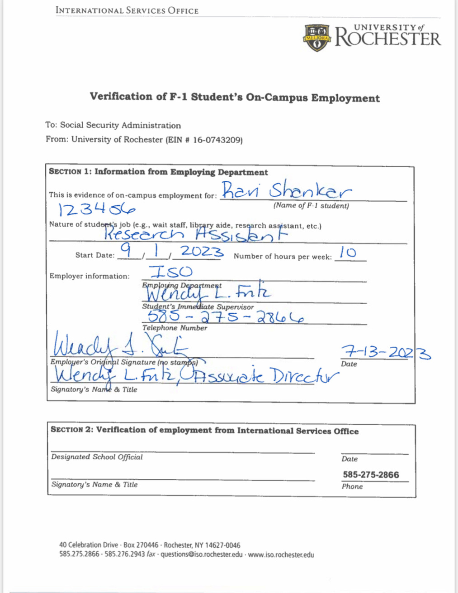
STEP 2: OBTAIN EMPLOYMENT DOCUMENTS - F-1 ON-CAMPUS
After hiring, your new employer will complete a Verification of F-1 Student’s On-Campus Employment Letter.
  Your name must match your passport / I-20 (no nicknames / preferred names)
  The letter must be printed on department letterhead
  Your employer must sign the letter in ink (no digital signatures / scans)
  Mail the original letter to the ISO--Box 270446
ISO will certify the letter and email you when it is ready to be collected from our office in College Town.

Slide 6
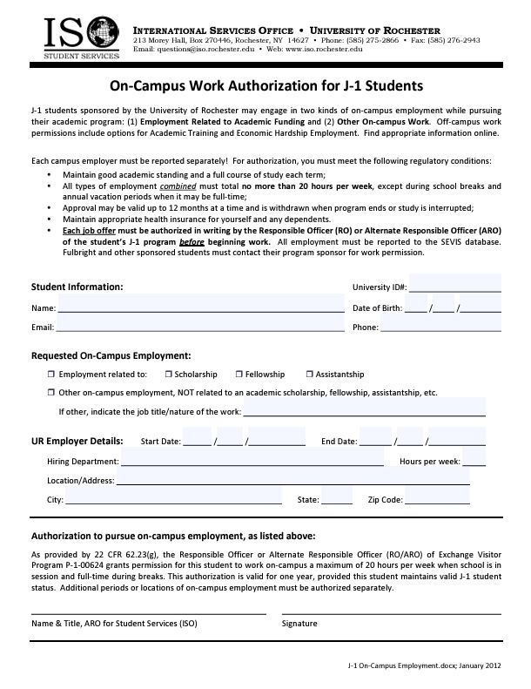
STEP 2: OBTAIN EMPLOYMENT DOCUMENTS - J-1 ON-CAMPUS
Specific permission is required for J-1 students who want to engage in on-campus employment.
Your program sponsor must update your SEVIS record to authorize the employment before you start working. If you are sponsored by the University of Rochester, please use the J-1 On-Campus Employment Authorization form to provide your employment details to the ISO for approval.
Once the employment has been authorized, you can contact tax@iso.rochester.edu to request a letter for SSA.

Slide 7
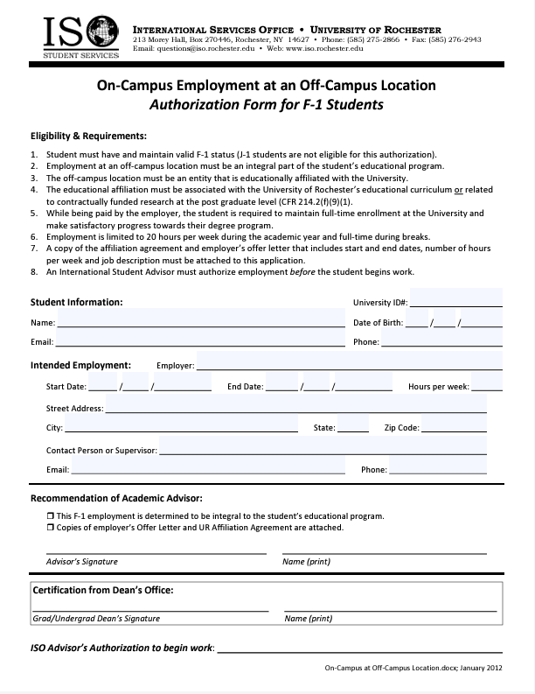
STEP 2: OBTAIN EMPLOYMENT DOCUMENTS - F-1 ON/OFF EMPLOYMENT
After hiring, you must work with your Academic Advisor to complete an On-Campus Employment at an Off-Campus Location Authorization Form.
Submit the form to ISO via URcompass, along with a copy of your Employment Offer Letter and the Affiliation Agreement.
ISO will authorize the employment and email you a copy of the signed form.

Slide 8
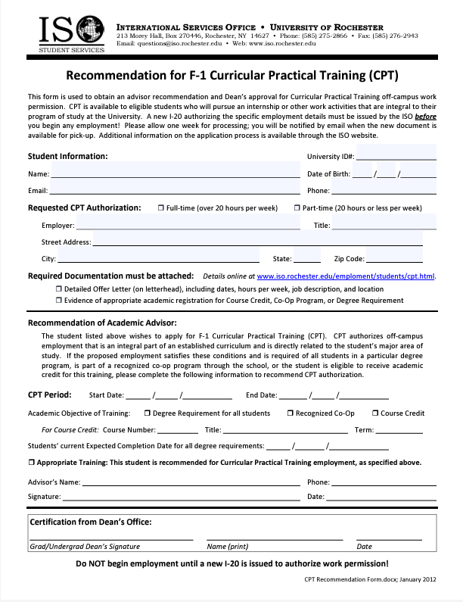
STEP 2: OBTAIN EMPLOYMENT DOCUMENTS - F-1 CPT
Documentation required to request CPT:
  Detailed offer letter
  Evidence of Academic Objective
Then, submit ISO's Request for Curricular Practical Training (CPT) e-form in URcompass.
After your CPT has been authorized in SEVIS, the new I-20 listing the CPT authorization on page 2 will be emailed to you.

Slide 9
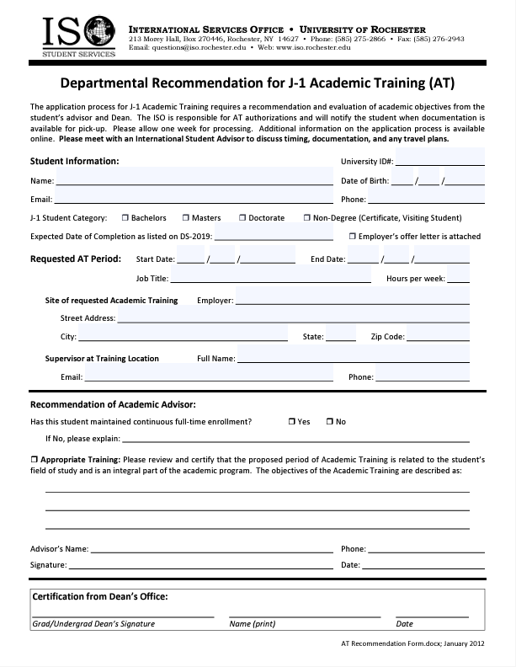
STEP 2: OBTAIN EMPLOYMENT DOCUMENTS - J-1 AT
AT authorization is granted by your J-1 program sponsor.
University-sponsored J-1 students need to submit the following documents to the ISO via URcompass for AT authorization:
  AT Recommendation Form
  Detailed offer letter
After your AT has been authorized in SEVIS, you will be issued a new DS-2019 with Academic Training listed on page 1.

Slide 10
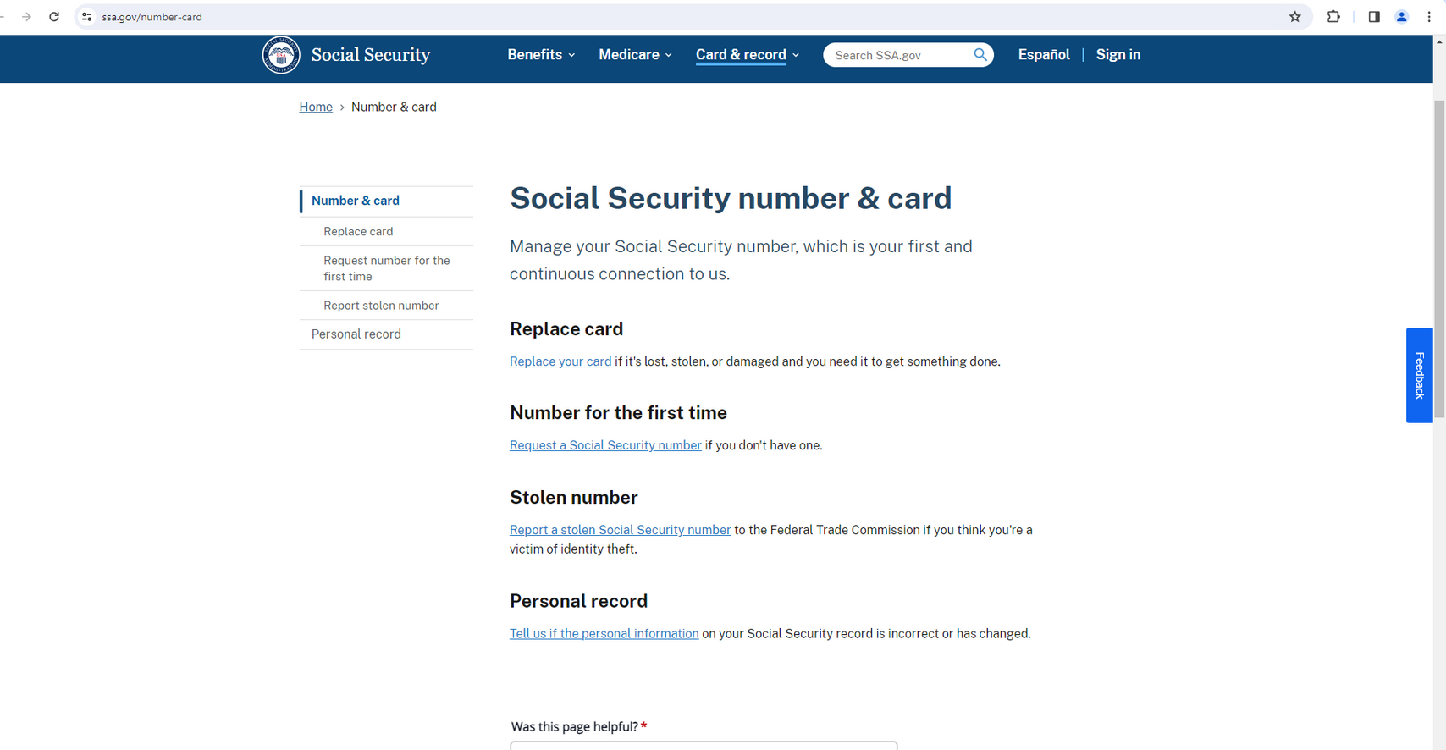

STEP 3: BEGIN SSN APPLICATION ONLINE
You cannot apply for your SSN until you are within 30 days of your employment start date.
Begin your SSN application online at ssa.gov/number-card.
Click ‘Request a Social Security number’ and then ‘Start application’.
After you submit your online request successfully, you must visit your local Social Security office with your documentation within 45 calendar days. You may be eligible to schedule an appointment before visiting.

Slide 11
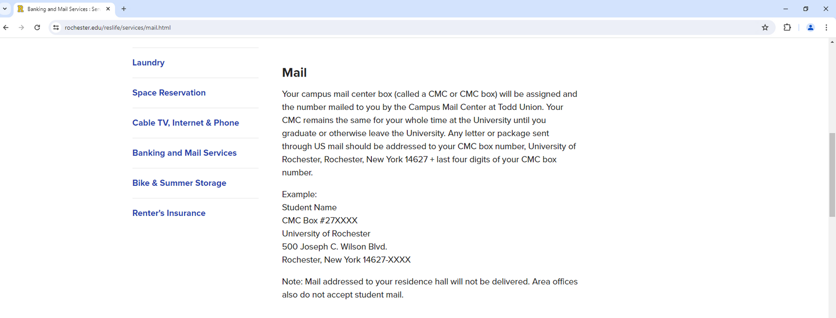

IMPORTANT INFORMATION
  The name you enter in your SSN application must match the name on your passport.
  You must have your Social Security card mailed to your personal U.S. mailing address. If you have a campus mail center (CMC) box, make sure you enter the address correctly.
  If you are not given the option to schedule an appointment, the Rochester Social Security office also offers a walk-in service.

Slide 12

STEP 4: BRING DOCUMENTS TO SOCIAL SECURITY OFFICE
You will need:
  Original Passport & Student Visa
  I-20 or DS-2019 (you must print and sign in ink)
  Printed I-94 Admission Record (or paper card)
If you have on-campus employment, you’ll also need:
  Verification of F-1 On-Campus Employment Letter, or
  J-1 Social Security Letter
If you have On/Off employment, you’ll also need:
  Verification of F1 On-Campus Employment at an Off-Campus Location Letter
  Affiliation Agreement, and
  Job Offer Letter

Slide 13

STEP 4: BRING DOCUMENTS TO SOCIAL SECURITY OFFICE
The Social Security office in Rochester is located at:
200 E Main St 2nd Floor, Rochester, NY 14604
Hours: Monday-Friday 9:00am - 4:00pm
Telephone: (800) 772-1213

Slide 14
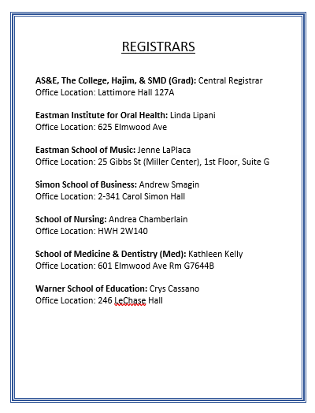
STEP 5: REPORT YOUR SSN
After you receive your Social Security Card in the mail, you must:
  Report the number to the Registrar at your respective school. You will want to do this in person. Do not put your SSN in an email.
In addition, students hired by UR must also:
  Take the card to the Human Resource Service Center.
  Update the information on your Sprintax Calculus Profile.

Slide 15

SPRINTAX CALCULUS
If you receive payments from the University, you must complete a Sprintax Calculus profile.
Sprintax Calculus is tax compliance software used by Payroll to determine tax residency status, tax treaty benefits eligibility and appropriate tax withholdings.
If you have issues accessing Sprintax Calculus, or concerns about the amount of taxes withheld from your paycheck, contact Payroll: FNPayroll@ur.rochester.edu

