Slide 1
J-1 Eform TraininG
Introduction to E-forms for J Exchange Visitors

Slide 2
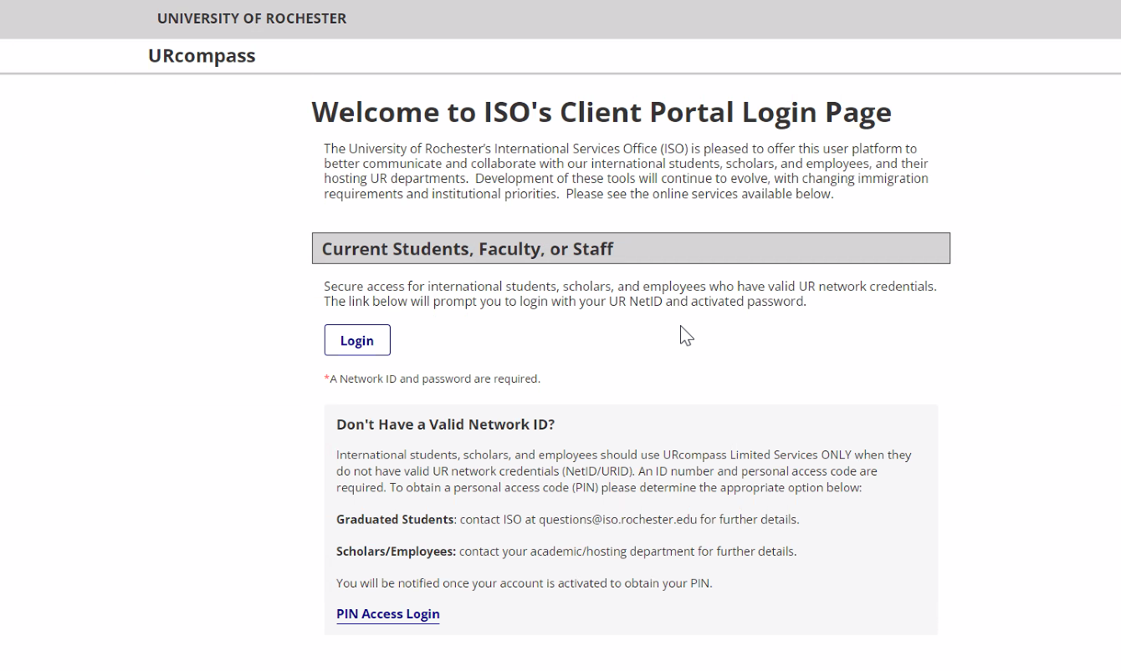
UR Compass
Welcome to ISO's Client Portal Login Page (rochester.edu)
https://urcompass.ur.rochester.edu/istart/controllers/start/StartEngine.cfm

Slide 3
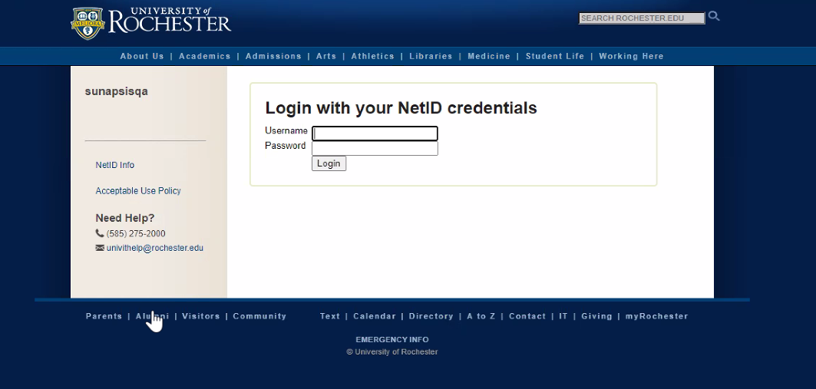
Login
You will login to UR Compass with your Net ID and password

Slide 4
Login
If this is your first time logging in to UR Compass, you will need to request Departmental Access.
Welcome to the U of R! Here are instructions for requesting an account and access to URcompass (the ISO client portal): 1. Go to the ISO URcompass website: https://urcompass.ur.rochester.edu/ 2. Click on the "Login" button located at the top of the page. 3. Use your NetID and password to access the system. 4. You will be taken to a screen to request a new account. a Indicate that you are requesting a “Department” account b Click on the “Request Account” button. 5. Fill out the departmental account request form with your name and contact information (email, phone number, and department) a Once you have completed the form, click the "Submit" button. 7. Your request will be sent to the URcompass website administrators for review. 8. You will receive an email notification once your departmental account has been created.

Slide 5
Departmental services
After you have successfully logged into UR Compass, you will choose Departmental Services from the list on the lefthand side of the screen

Slide 6
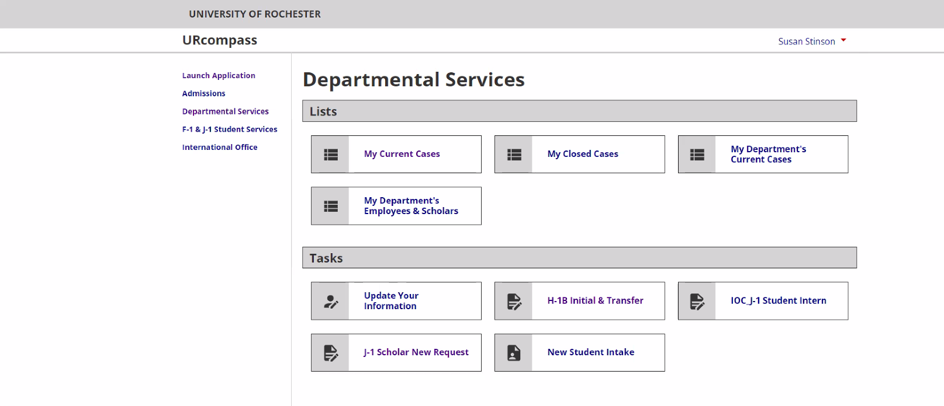
J-1 scholar new request
Once in the Departmental Services menu, choose J-1 Scholar New Request

Slide 7
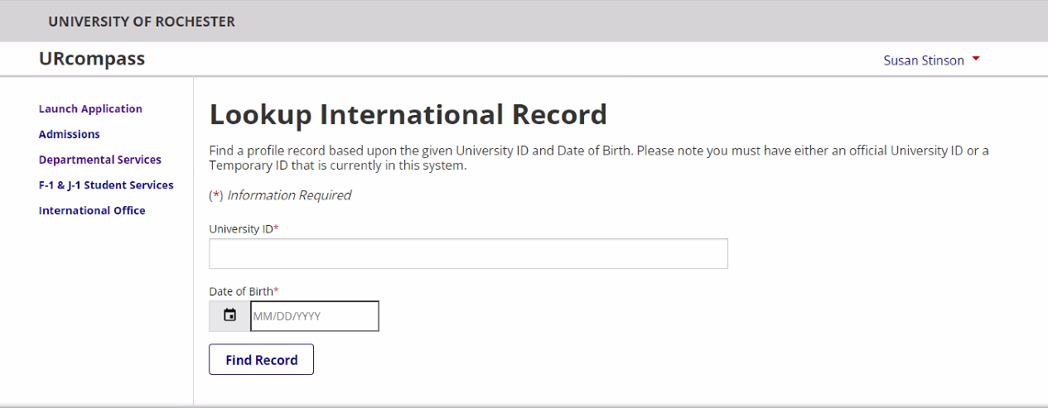
LOOk up scholar
Next you will lookup the scholar in the system by the University ID and date of birth

Slide 8
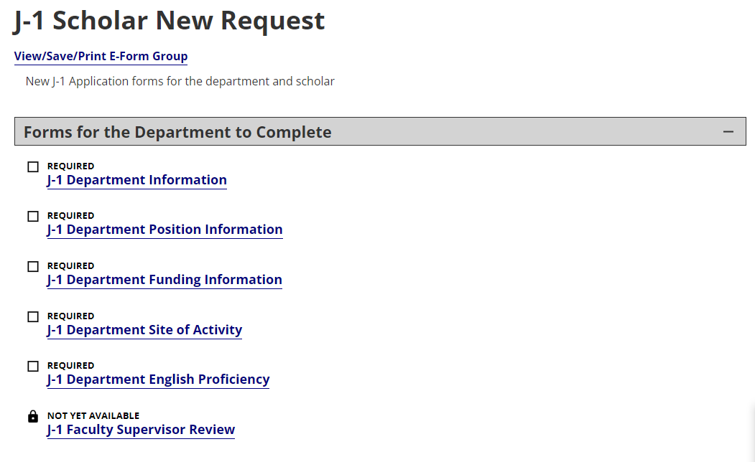
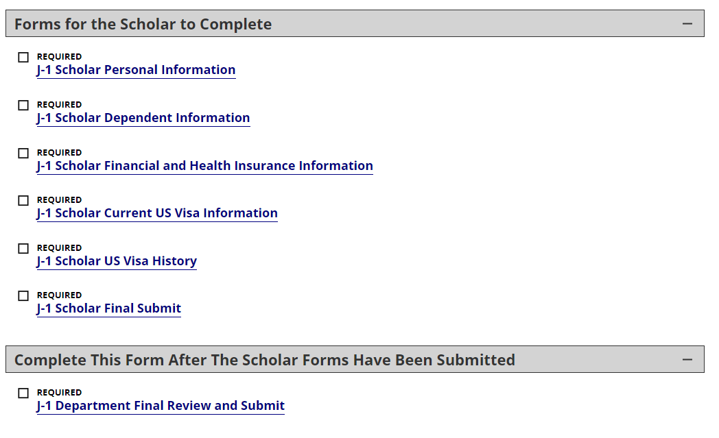
List of Eforms to be filled out by the department and the scholar
Once you have looked up the scholar record, complete the Eforms in the order listed

Slide 9
Automated Email notification is sent
Once the ‘J-1 Faculty Supervisor Review’ has been submitted, you will receive a confirmation email:
Dear Sandy Smith,
Thank you for submitting the J-1 New Scholar Request for Gavin Henry.
The exchange visitor has been invited to complete their J-1 Scholar forms.
The faculty supervisor has been asked to review the information you provided.
You will receive an email letting you know when the exchange visitor has completed their forms and you can submit everything to the chair for approval.
International Services Office Scholar and Employee Services Email: scholars@iso.rochester.edu Web: https://www.iso.rochester.edu/

Slide 10
Automated Email notification is sent to the scholar
The Scholar will receive the following email inviting them to complete their E-forms:
Dear Gavin Henry,
A J-1 visa request has been started by a department at University of Rochester. Your action is required in order to proceed with this request. Please login to URCompass and submit all the Scholar forms.
You will need to have digital copies of the following:
Copy of identity pages of a valid passport for J-1 applicant
Current curriculum vitae
Proof of permanent residency if applicant is a citizen of one country but legal permanent resident of another
Copies of degrees and certificates earned
People who are not going to be paid by the University of Rochester MUST provide proof of funding.
If transferring to the University of Rochester, provide copies of:
Current DS-2019
Current I-94 card
Current J-1 visa stamp
If you have any J-2 dependents, you will need to upload a digital copy of their passport(s), marriage certificate, and/or birth certificate.
Please login here with your University of Rochester ID to proceed:
URCompass

Slide 11
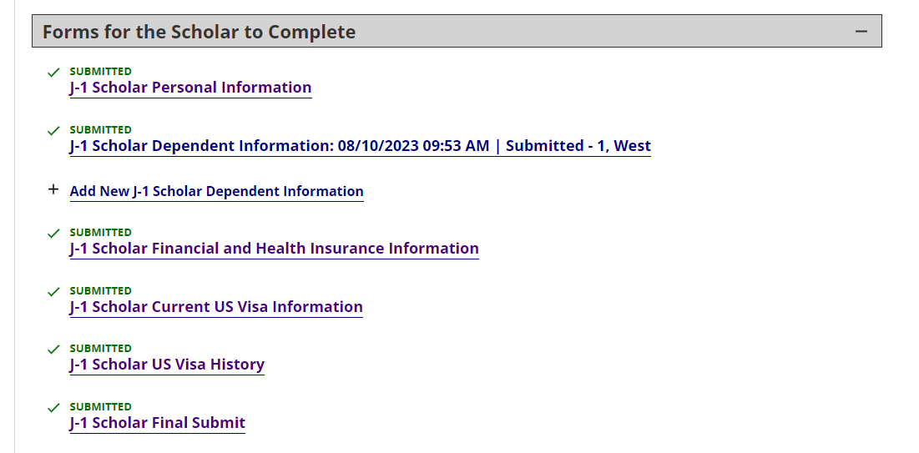
Forms for the scholar to complete
The Scholar will log in and complete the following E-Forms:

Slide 12
Automated Email notification is sent to the scholar
When the Scholar has submitted all of their E-forms, they will receive a confirmation email:
Dear Gavin Henry,
Thank you for completing the necessary forms for your J-1 visa paperwork request. At this time your department has been notified that your forms are complete. They will finalize your application and then it will be routed to our office for processing.
If we need any additional information we will contact you.
International Services Office Scholar and Employee Services Email: scholars@iso.rochester.edu Web: https://www.iso.rochester.edu/

Slide 13
Returning to the final department e-form
Once the Scholar has submitted all of their E-forms, you will receive an email inviting you to return to the J Visitor Application to Submit the Request to the Department Chair.
Dear Sandy Smith,
The J-1 visa request has been submitted by Gavin Henry. Please login to URCompass to review and send on for approval to your department chair.
International Services Office Scholar and Employee Services Email: scholars@iso.rochester.edu Web: https://www.iso.rochester.edu/

Slide 14
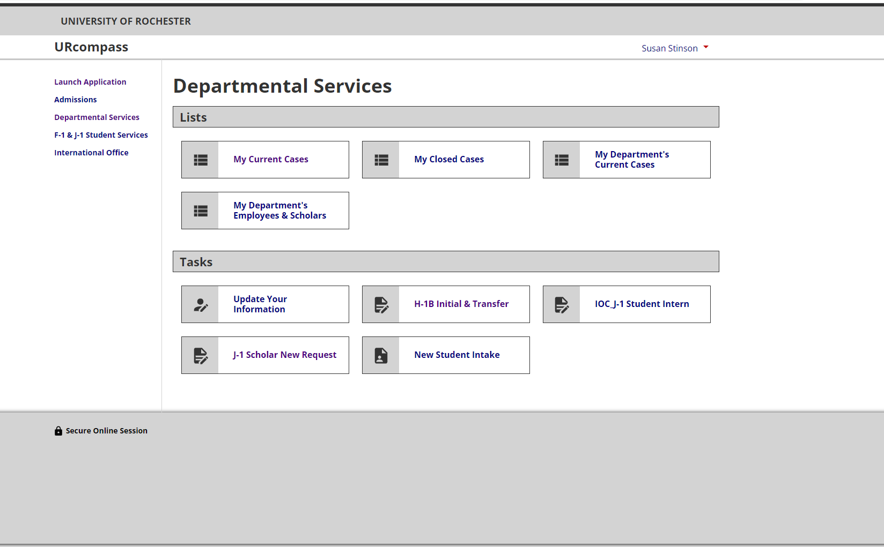
Returning to the final department e-form
Click on the link in the email, and login to URCompass. Select ‘My Current Cases’ and then click on the J-1 Scholar case you are working on.

Slide 15
Submit the final department e-form
After looking up the Scholar, complete the J-1 Department Final Review And Submit E-Form.
ONCE THE FINAL E-FORM IS SUBMITTED, ISO WILL BE NOTIFIED OF THE NEW J-1 SCHOLAR APPLICATION. WE WILL REVIEW THE APPLICATION AND IF COMPLETE, WORK TO PROCESS THE
DS-2019. IF THE APPLICATION IS NOT COMPLETE, WE WILL REACH OUT FOR THE MISSING INFORMATION OR DOCUMENTS.
IF THE APPLICATION IS COMPLETE, PLEASE ALLOW TWO WEEKS PROCESSING TIME FOR THE INITIAL DS-2019.

Slide 16
Coming soon
The J-1 Scholar New Request will be available soon! We will let you know as soon as the Eforms are LIVE.
We are also excited to have the following Eforms launching in the next few months:
J-1 Scholar Extension
J-1 Student Intern
J-1 Scholar – Add Dependent
H-1B Initial & Transfer
H-1B Extension

