Slide 1
H-1B Eform Training
Introduction to E-forms for H-1B Employees

Slide 2
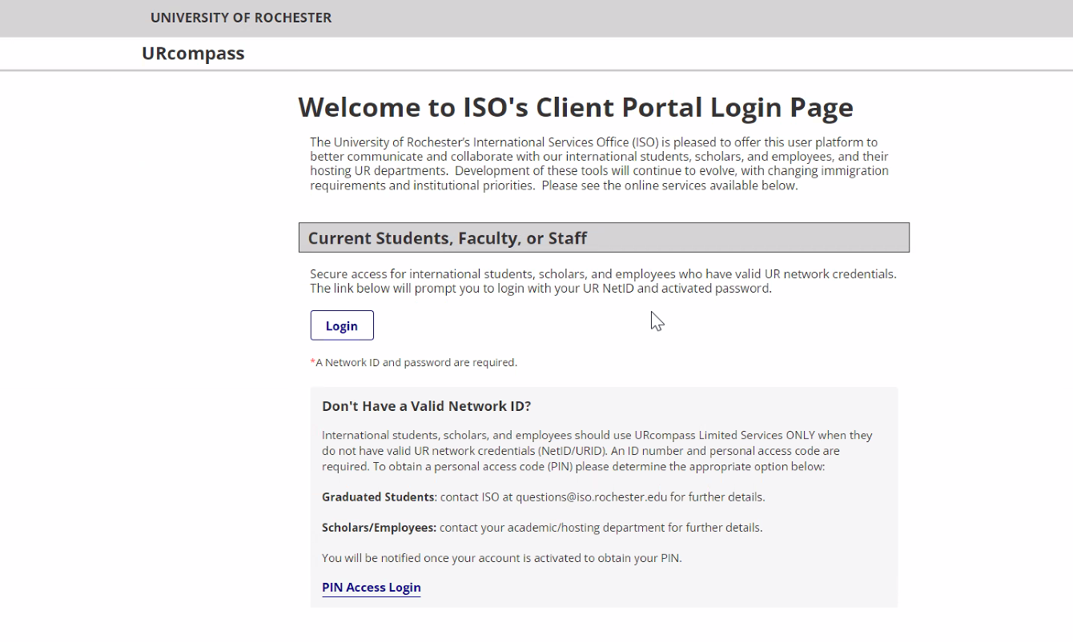
UR Compass
Welcome to ISO's Client Portal Login Page (rochester.edu)
https://urcompass.ur.rochester.edu/istart/controllers/start/StartEngine.cfm

Slide 3
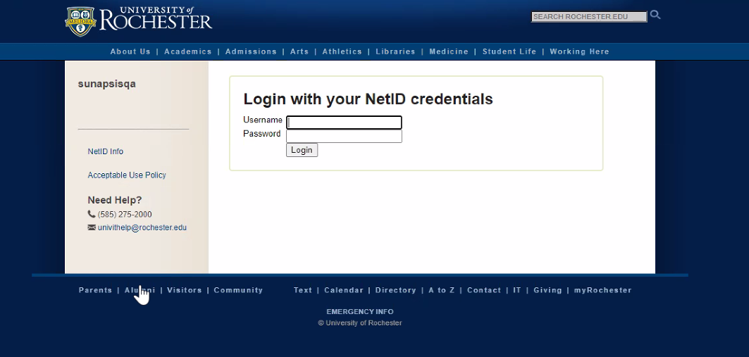
Login
You will login to UR Compass with your Net ID and password

Slide 4
Login
If this is your first time logging in to UR Compass, you will need to request Departmental Access.
Welcome to the U of R! Here are instructions for requesting an account and access to URcompass (the ISO client portal): 1. Go to the ISO URcompass website: https://urcompass.ur.rochester.edu/ 2. Click on the "Login" button located at the top of the page. 3. Use your NetID and password to access the system. 4. You will be taken to a screen to request a new account. a. Indicate that you are requesting a “Department” account b. Click on the “Request Account” button. 5. Fill out the departmental account request form with your name and contact information (email, phone number, and department) 6. Once you have completed the form, click the "Submit" button. 7. Your request will be sent to the URcompass website administrators for review. 8. You will receive an email notification once your departmental account has been created.

Slide 5
Departmental services
After you have successfully logged into UR Compass, you will choose Departmental Services from the list on the lefthand side of the screen

Slide 6
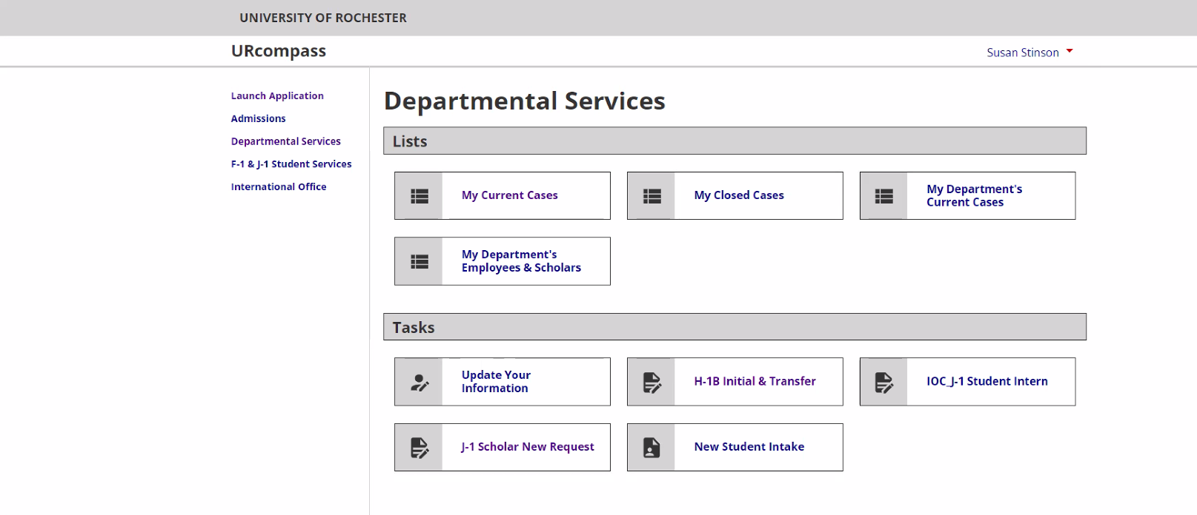
H-1B initial and transfer request
Once in the Departmental Services menu, choose H-1B Initial & Transfer

Slide 7
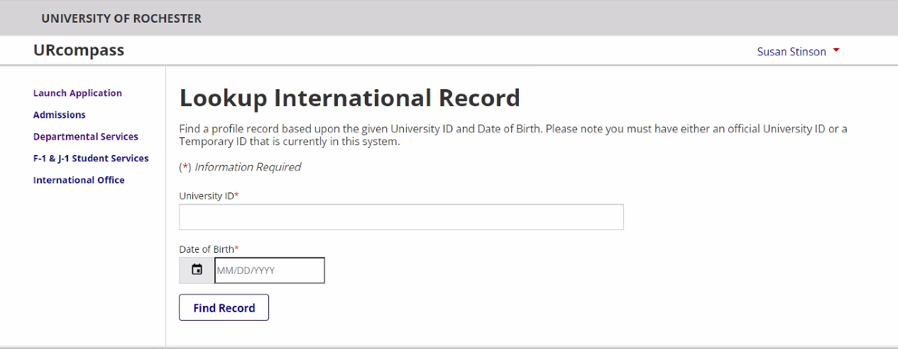
LOOk up employee
Next you will lookup the employee in the system by the University ID and date of birth

Slide 8
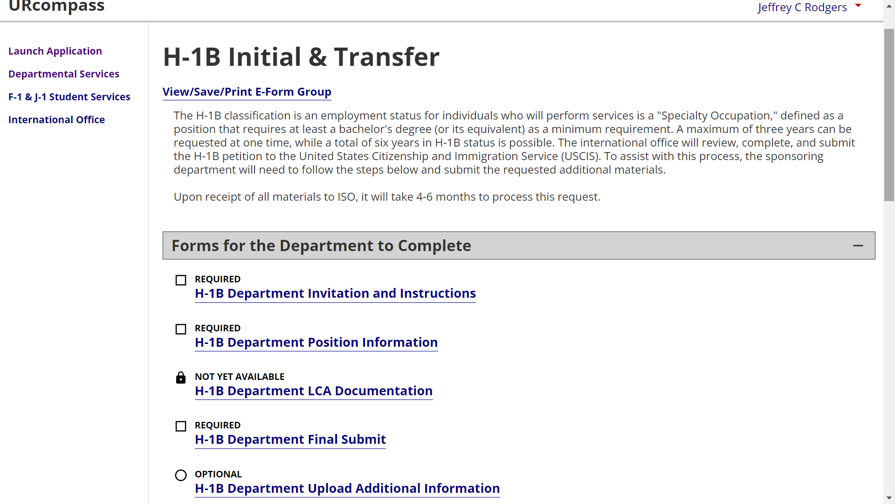
List of Eforms to be filled out by the department
Once you have looked up the employee record, complete the Eforms listed under the “Forms for the Department to Complete” section
After the H-1B Department Final Submit is submitted, you will wait for the Employee to complete their E-forms in the portal.

Slide 9
Automated Email notification is sent
Once the “H-1B Department Final Submit” has been submitted, you will receive a confirmation email:
Dear Julie Jones,
Thank you for submitting the H-1B departmental eforms for Margot Nigel. We will let you know when Margot Nigel has completed their employee eforms.
If you need to provide additional information or documentation, you may return to the application for Margot and submit the “Department Upload Additional Information” eform.
International Services Office Scholar and Employee Services Email: scholars@iso.rochester.edu Web: https://www.iso.rochester.edu/

Slide 10
Automated Email notification is sent to the employee
The Employee will receive the following email inviting them to complete their E-forms:
Dear Margot Nigel,
An H-1B visa request has been started by a department at University of Rochester. To proceed with this request, your action is required. Please login to URCompass and submit all the Employee forms.
Whether you are outside or inside the U.S, you will need to have digital copies of the following:
Identity page of a valid passport
Degrees and transcripts in both the original language and English
A credential evaluation is required for degrees received outside the U.S.
Copy of current curriculum vitae or resume
If you are in the U.S., along with the documents listed above, you will need to have digital copies of the following:
Electronic I-94 obtained from cbp.gov
Copy of recent visa sticker
Last two months’ pay statements, if employed
Applicable immigration documentation
MEDICAL DOCTORS or DENTISTS ONLY
Medical degree or dentistry degree and license in home country, translated into English.
ECFMG certificate documenting valid (not expired or about to expire) English exam certification OR Pass results of ECFMG English exam (Not required of graduates from accredited Canadian medical schools.)
Pass results of: USMLE – Steps I, II and III OR NBME – Parts I, II and III OR FLEX Parts I and II (Please note combinations of exams (e.g. USMLE – Steps I and II and FLEX-Component II) are not acceptable
Copy of New York State medical or dental license.
Proof of residencies, fellowships and board certifications
If you have any H-4 dependents, you will need to upload a digital copy of their passport(s), marriage certificate, and/or birth certificate and any immigration documents (I-20s; Ds-2019s; visa stamps; EADs; etc.)
Please login here with your University of Rochester ID to proceed:
URCompass
If you encounter any problems with URCompass please contact questions@iso.rochester.edu for assistance.

Slide 11
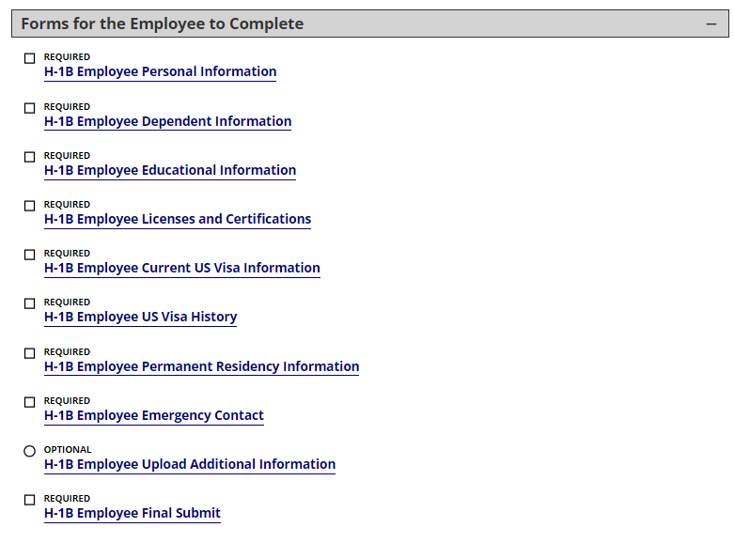
Forms for the employee to complete
The Employee will log in and complete the following E-Forms:

Slide 12
Automated Email notification is sent to the employee
When the Employee has submitted all their E-forms, they will receive a confirmation email:
Dear Margot Nigel,
Thank you for submitting your H-1B eforms. Your department has been notified that your forms are complete.
If you need to provide additional information or documentation, you may return to your application using your University ID ( %universityid% ) and your Date of Birth and submit the Employee Upload Additional Information eform.
If we need any additional information, we will contact you.
International Services Office Scholar and Employee Services Email: scholars@iso.rochester.edu Web: https://www.iso.rochester.edu/

Slide 13
Automated Email notification is sent to the department
Once the Employee has submitted all their E-forms, you will receive an email inviting you to review the forms.
Dear Julie Jones,
The H-1B Employee e-forms have been submitted by Margot Nigel. Please login to URCompass to review.
International Services Office Scholar and Employee Services Email: scholars@iso.rochester.edu Web: https://www.iso.rochester.edu/

Slide 14
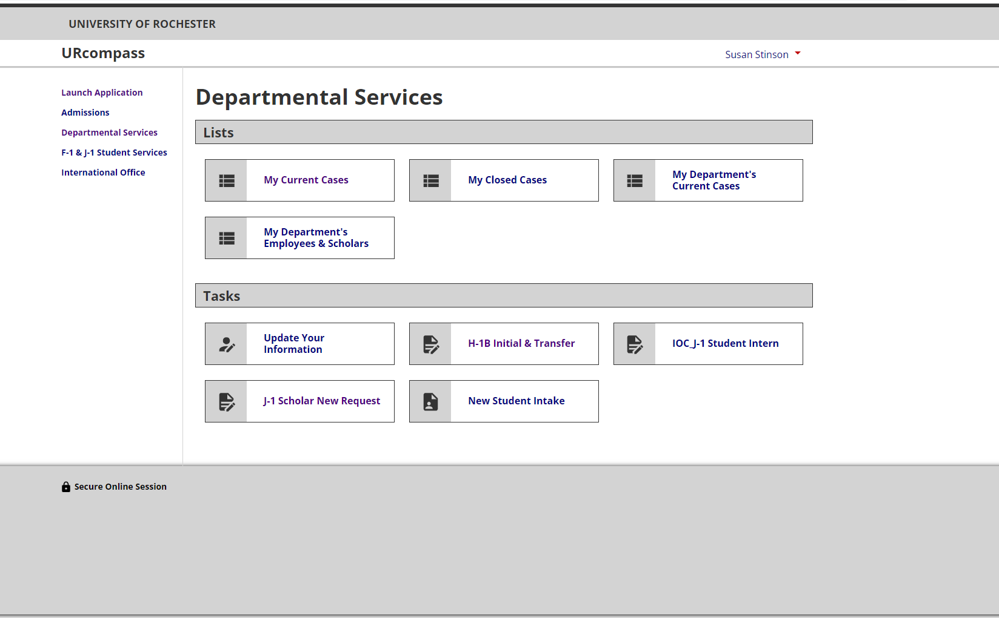
Reviewing the employee e-form

Slide 15
ISO BEGINS PROCESSING OF H-1B REQUEST
ONCE THE E-FORMS ARE SUBMITTED, ISO WILL BE NOTIFIED OF THE H-1B REQUEST.
WE NEED TO RECEIVE ALL DOCUMENTS SIX (6) MONTHS BEFORE THE H-1B START DATE.
IF THE REQUEST IS NOT COMPLETE, WE WILL REACH OUT FOR THE MISSING INFORMATION OR DOCUMENTS.

